Slide 1
MAKE MONEY WORK FOR YOU!

Slide 2
MONEY WORKS
Session 3
Session 1
Banking & Being Informed
Session 4
Budgeting & Household Costs
Session 2
Borrowing & Avoiding Scams
Your Income

Slide 3
YOUR INCOME
Sources of Income
Minimum Wages
Tax – how much and why?
Benefits – The changes
Sanctions
Session 2

Slide 4
Sources of Income
?
?
?
?
?
?
?
?
Notes:
Two key questions to ask the group to observe:
What stereotypes are being portrayed in the video
What do these do to the perception of people on benefits

Slide 5
Sources of Income
Job – FT / PT / 0 Hr
Student Loan
Pension payments
Universal Credit
Other Benefits – JSA, PIP
Freelance/Self Employed
Bursaries and Grants
Inheritance
Interest & Returns
Notes:
Freelance gig economy
Carers allowance
Pocket money

Slide 6
MAKE MONEY STANDING IN LINE
Notes:
Two key questions to ask the group to observe:
What stereotypes are being portrayed in the video
What do these do to the perception of people on benefits

Slide 7
Minimum Wage
The minimum amount per hour you should get paid for working
AGE
AMOUNT
16-17
£4.81
18-20
£6.83
21-22
£9.18
23+
£9.50
Apprentice
£4.81
Living Wage (London/Out of London)
£11.05/£9.90
Notes:
Two key questions to ask the group to observe:
What stereotypes are being portrayed in the video
What do these do to the perception of people on benefits

Slide 8
WORKING HOURS
Circumstance
Limits
16-17
18+
Trainee Doctors
Those in armed forces, emergency services and police
8 hours per day / 40 hours per week
48 hour limit (can opt out)
48 hour limit
Exempt from 48 hours limit in some cases
Employers can’t force adults to work more than 48 hours a week on average

Slide 9
ZERO HOUR CONTRACTS
Zero hour contracts are also known as ‘casual contracts’
Zero hour contracts are usually for ‘piece work’ or ‘on call’ work, e.g. interpreters
This means:
They are on call to work when you need them
You don’t have to give them work
They don’t have to do work when asked
Zero hour workers are entitled to statutory annual leave and the National Minimum Wage in the same way as regular workers

Slide 10
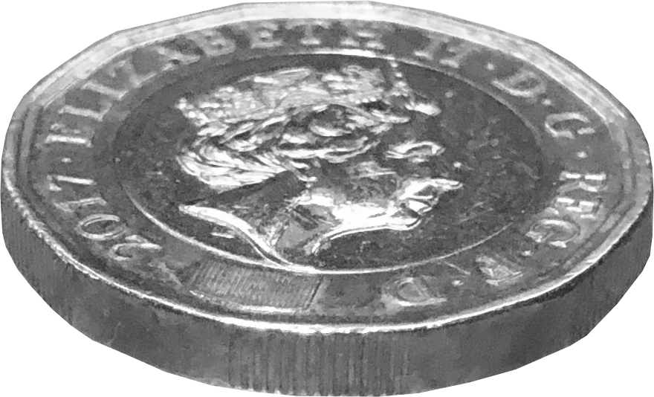
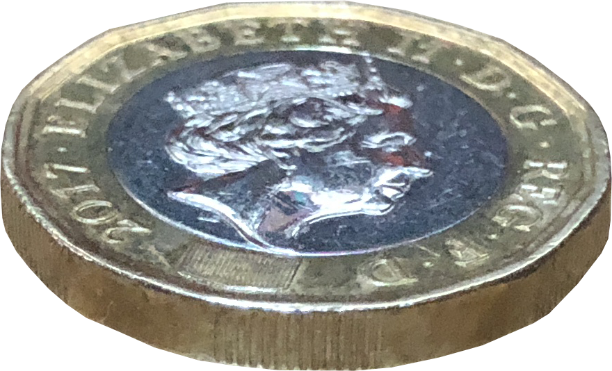
INCOME TAX
£150,000
45%
£50,271 - £150,000
40%
£12,571 - £50,270
20%
< £12,570
0%
Tax free allowance

Slide 11
Salary of
£15,000
£807.98
£14192.02
Annual Net Pay
Annual Tax & NIC
Notes:
Based on new NI figures from July 1st 22

Slide 12
Salary of
£26,000
£4,465.48
£21,534.52
Annual Net Pay
Annual Tax & NIC
Notes:
Based on new NI figures from July 1st 22

Slide 13
Salary of
£75,000
£28,230.98
£51,769.02
Annual Net Pay
Annual Tax & NIC
Notes:
Based on new NI figures from July 1st 22

Slide 14
Salary of
£250,000
£108,946.50
£141,053.50
Annual Net Pay
Annual Tax & NIC
Notes:
Based on new NI figures from July 1st 22

Slide 15
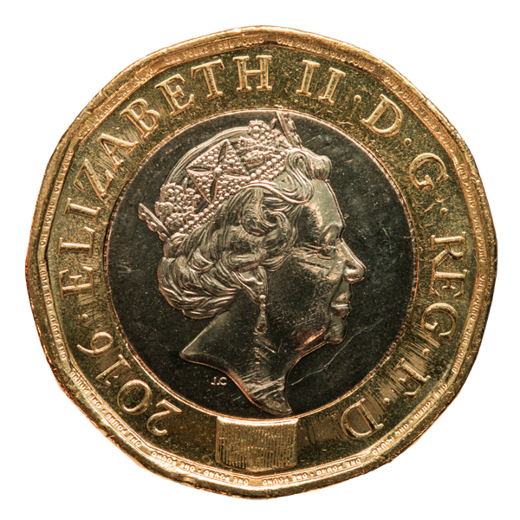
WHERE DOES MY TAX GO?
Notes:
Now a pie chart – can be edited every year. This is 20-21 tax year figures (Latest available)

Slide 16
WHERE DOES MY TAX GO?
If you pay £3000 in tax and NI:
Welfare (19.6%) | £588 | Business and Industry (14.4%) | £432
Health (21.9%) | £657 | Government Administration (2%) | £60
State Pensions (10.10%) | £303 | Housing and Utilities, like street lighting (1.4%) | £42
Education (9.6%) | £288 | Culture, like sports, libraries, museums (1.2%) | £36
National Debt Interest (4.1%) | £123 | Environment (1.3%) | £39
Defence (4.5%) | £135 | Overseas Aid (0.9%) | £27
Transport (4.5%) | £135 | UK Contribution to the EU Budget (0.6%) | £18
Public Order and Safety (3.9%) | £117
Notes:
£3k tax figure is based on average tax/ ni spend for salary of £21000

Slide 17
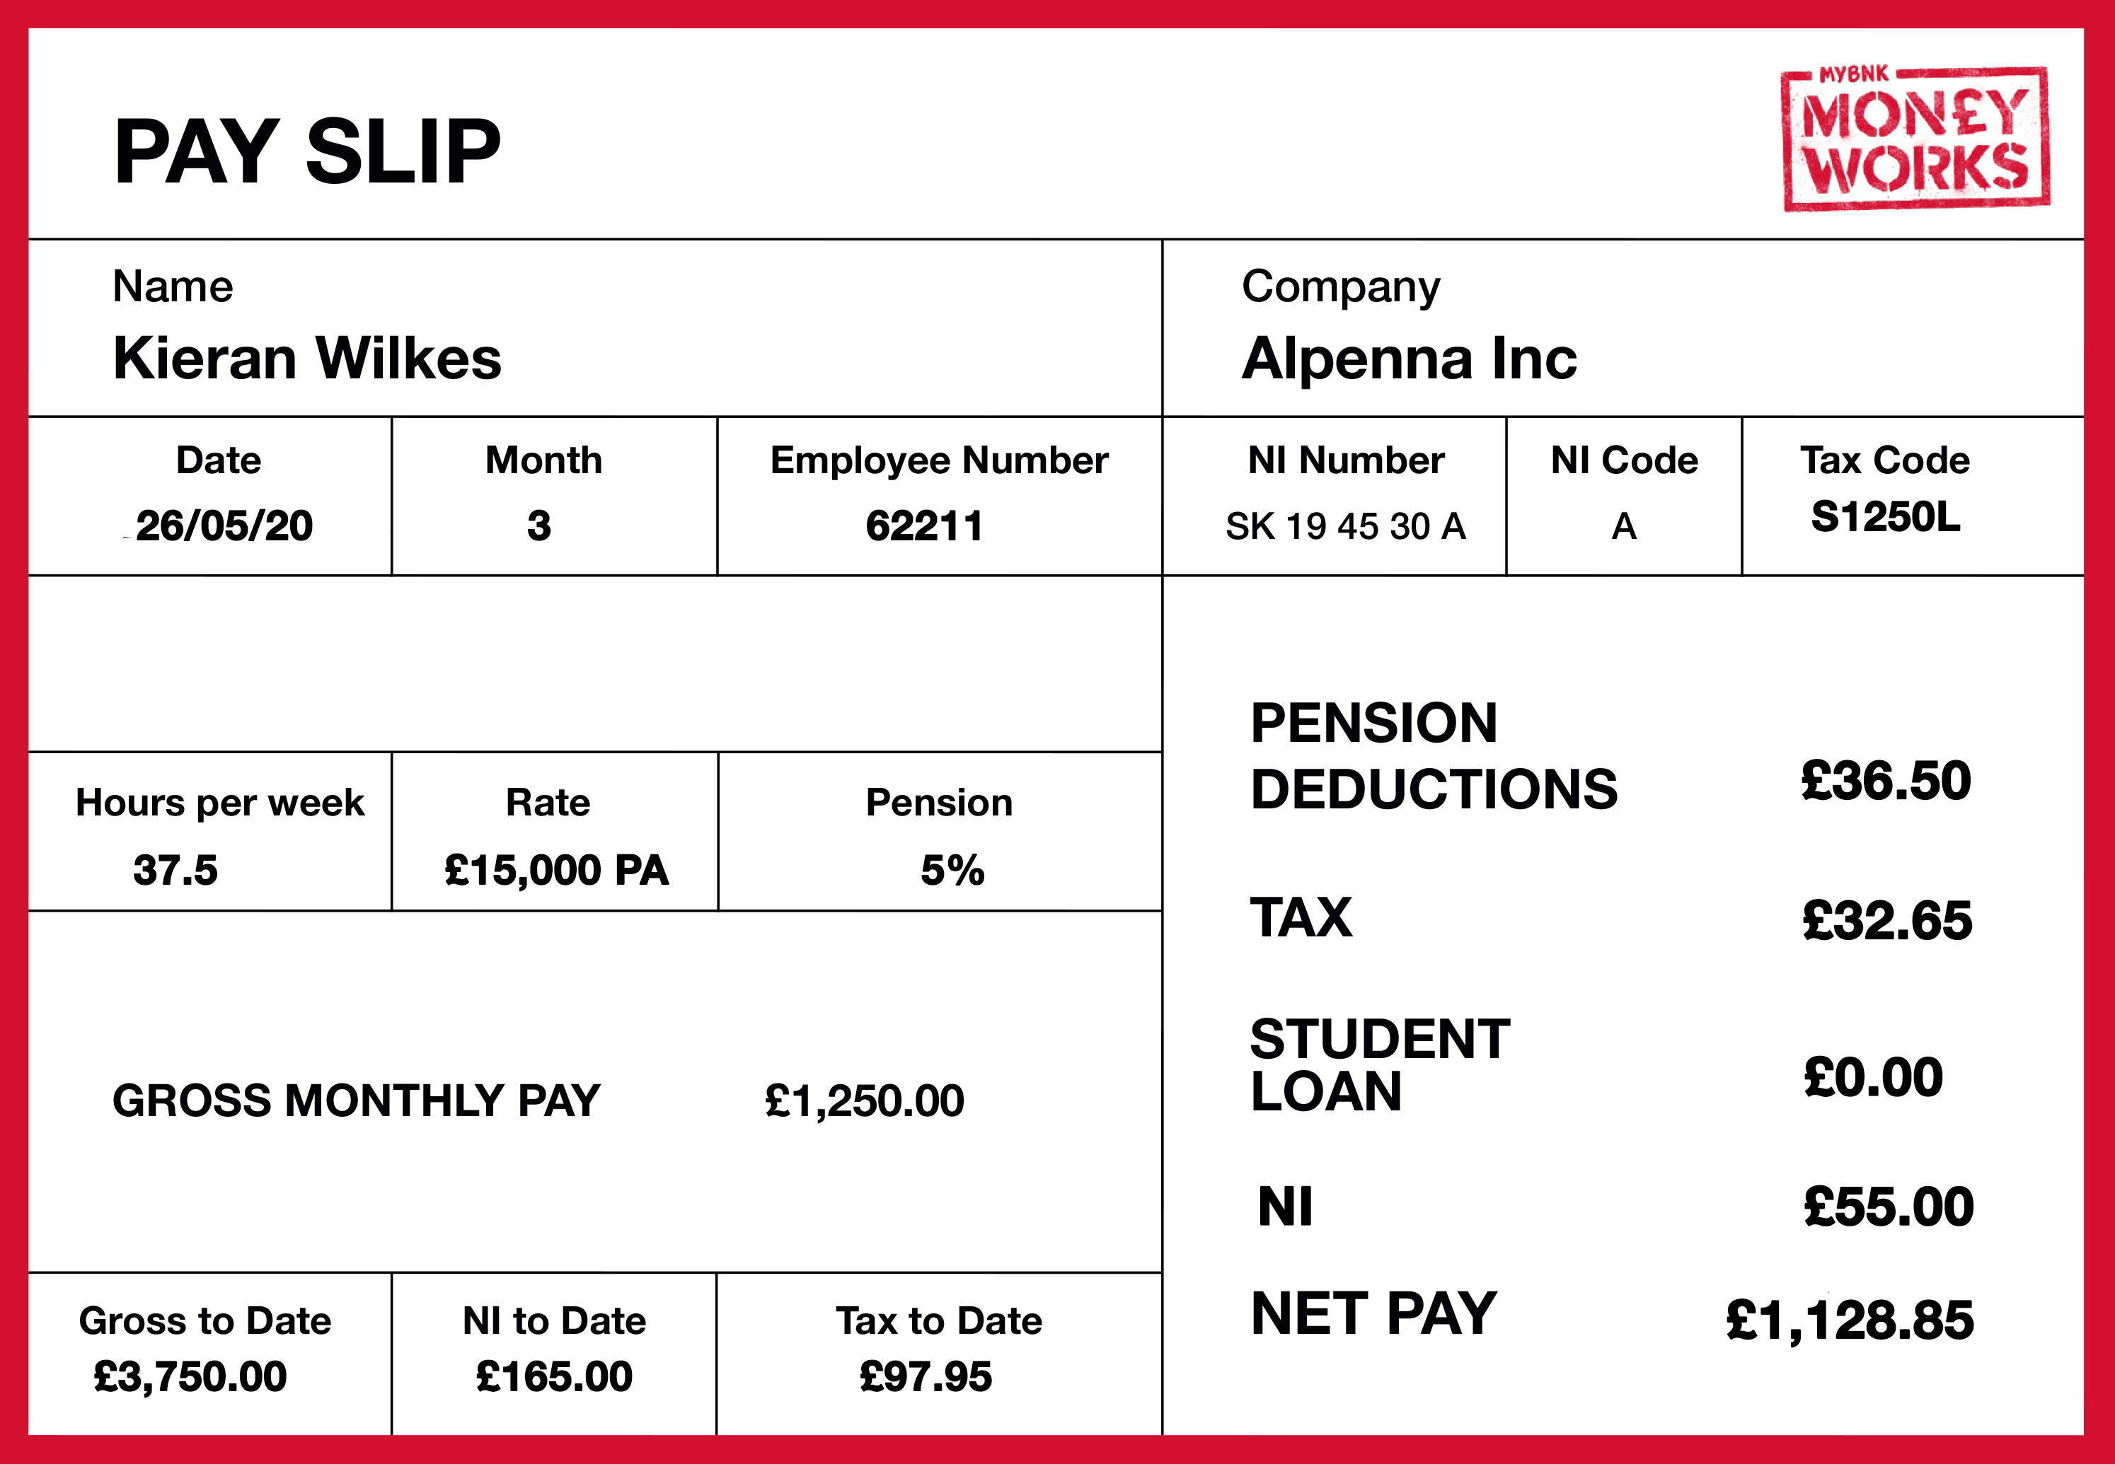
Salary and Tax
28/06/22
1257L
£62.50
£40.50
£26.83
£1,120.17
£3,750.00
£80.49
£121.50
Notes:
https://www.thesalarycalculator.co.uk/salary.php

Slide 18
Pay Slip Deductions
Student Loan
To pay off university borrowing
NI
NHS
Benefits
State Pensions
Private Pension
Additional funds for your future retirement
Tax
Healthcare
Roads
Schools
Defence

Slide 19
Auto Enrolment
£41.90
3%
8%
Salary
£111.83
£23,000
Pension
Pot
5%
£69.83

Slide 20
BENEFITS STREET

Slide 21
TRUE OR FALSE?
FALSE
You have to be in receipt of a benefit to get Housing Benefit
Notes:
It is dependent on your income so if you are on a low income, you may still get help

Slide 22
TRUE OR FALSE?
You have to pay back a budgeting loan / budgeting advance
TRUE
Notes:
It is interest free, you have to pay back within 104 weeks and you may be eligible if you have been getting income related benefits for at least 6 months NB: They’ll still be available until UC is fully rolled out in 2015

Slide 23
TRUE OR FALSE?
You can only get a maternity grant if you have worked
FALSE
Notes:
You qualify if you have no other children, are on income related benefits, and apply within 11 weeks of giving birth

Slide 24
TRUE OR FALSE?
Kelly Jones (23) got caught for benefit fraud when she appeared on the TV show Wife Swap
TRUE
Notes:
She was claiming to be a single mother and claimed almost £10,000 illegally! When actually, she was living with her husband. She got caught when the couple appeared on the TV show Wife Swap in 2010.
http://www.bbc.co.uk/news/10543250

Slide 25
TRUE OR FALSE?
FALSE
Benefit fraud costs the taxpayer 5 times more than tax evasion
Notes:
Tax evasion when people illegally don’t pay taxes by, e.g. not declaring all their income. Tax evasion is around 3% of total tax liabilities, while benefit fraud accounts for 0.8% of total benefit expenditure. http://citywire.co.uk/money/tax-evasion-costs-treasury-15-times-more-than-benefit-fraud/a378274
NB: Tax avoidance is when people pay LESS tax than they should, using legal loopholes (i.e. isn’t illegal, but still controversial!)

Slide 26
TRUE OR FALSE?
Most countries in the world have a benefit system
FALSE
Notes:
There are many countries that don’t provide free schooling, health or help when people are in need, even in some countries where people pay tax!

Slide 27
HOUSING BENEFIT
What is it?
Example Amounts
You may get Housing Benefit if you pay rent and your income (and savings and investments) are below a certain level. You could qualify if you are out of work, or in work and earning a low wage.
The shared accommodation rate (i.e. the maximum for a single person aged under 25) in the following Boroughs is:
Redbridge £79 a week
Lambeth £98 a week
Tower Hamlets £144 a week
How much do you get?
If private renting, your Housing Benefit will be calculated with the Local Housing Allowance rules.
Paid by:
Cheque or into your bank account

Slide 28
HOUSING BENEFIT
Restrictions
You can't usually get Housing Benefit if:
If you live with a partner, only one of you can get Housing Benefit
If you're single and aged under 35, you can only get Housing Benefit for bed-sit accommodation or one room in shared accommodation
you have savings of over £16,000
you live in the home of a close relative
you're a full-time student (unless you're disabled or have children)
you're an asylum seeker or are sponsored to be in the UK
Notes:
Even if it's included in your rent, you won't get any Housing Benefit for:
water charges
charges for heating, hot water, lighting, or cooking
payments for food or fuel in board and lodgings or hostels

Slide 29
BEDROOM TAX
What is it?
Impact
The Bedroom Tax – or “ending the spare room subsidy” – is the way the government makes social housing tenants pay for ‘spare’ rooms
14% of Housing Benefit will be deducted for one spare bedroom
25% of Housing Benefit will be deducted for more than one spare bedroom
Notes:
Benefit Cap – Exemptions
The following households will be exempt from the cap:
those entitled to:
Working Tax Credit
those in receipt of:
Disability Living Allowance
Industrial Injuries Benefits
Personal Independence Payment
Attendance Allowance
Employment and Support Allowance, if paid with the support component
Armed Forces Compensation Scheme and before 6 April 2005, the War
Widow’s/Widower’s pension and war disablement pension
claimants who have been in employment for 50 weeks out of 52 weeks or more when they claim benefit will be exempt from the cap for up to 39 weeks

Slide 30
BEDROOM TAX
Who gets a room?
One bedroom is allowed for each of the following:
A couple
A person who is not a child (age 16 and over)
Two children of the same gender (aged 10 and over but under 16)
Two children who are under 10 (regardless of gender)
Any other child

Slide 31
UNIVERSAL CREDIT
Universal Credit will replace several benefits with a single payment
Why?
When?
To simplify a complex benefits system
To make work pay
Now until 2023 (estimated)

Slide 32
UC EXPLAINED
Current System
New system
Income related JSA
Income related ESA
Income Support
Working Tax Credits
Child Tax Credits
Housing Benefit
Universal credit
Personal independence payment
Disability living allowance

Slide 33
APA’S
Alternative Payment Arrangements are for those claimants who cannot manage their single monthly payment and there is a risk of financial harm to the claimant and/or their family.
The following APAs are available to help claimants who need additional support:
paying housing costs of Universal Credit as a Managed Payment (MP) direct to the landlord
more frequent than monthly payments
split payment of an award between partners

Slide 34
APA’S CONTINUED
Who can ask for an APA?
You can usually ask for an APA if you have:
addiction problems
rent arrears
mental health issues
learning difficulties
been previously homeless

Slide 35
Pension Credit, Child Benefit, Carer’s Allowance
(will remain)
Council Tax Benefit
(Localised Council Tax Schemes)
Contributory JSA and ESA
(will remain)

Slide 36
UNIVERSAL CREDIT
Making work pay
£500
Universal Credit: lone parent with two children
£400
£300
Total in-pocket income
£200
Universal Credit payment
£100
£100
£200
£300
£400
£500
£600
£700
Notes:
Benefits will now progressively decrease rather than you being cut off all benefits once you work over 16hrs.

Slide 37
Universal Credit
Universal Credit
Earnings
Out of work
In work
Notes:
Benefits will now progressively decrease rather than you being cut off all benefits once you work over 16hrs.

Slide 38
SANCTIONED

Slide 39
YOUR INCOME
Sources of Income
Minimum Wages
Tax – how much and why?
Benefits – The changes
Sanctions
Session 2

Slide 40
BANKING & BEING INFORMED
How banks work & Interest
Savings & current accounts
Forms of payment
Online banking system
Understanding contracts & tenancies
Session 3

Slide 41
MAKE MONEY WORK FOR YOU!

