Slide 1
MAKE MONEY WORK FOR YOU!

Slide 2
MONEY WORKS
Session 3
Session 1
Banking & Being Informed
Session 4
Budgeting & Household Costs
Session 2
Borrowing & Avoiding Scams
Your Income

Slide 3
BANKING & BEING INFORMED
How banks work & Interest
Savings & current accounts
Forms of payment
Online banking system
Understanding contracts & tenancies
Session 3

Slide 4
WHEN BANKS GO WRONG
Notes:
Ask groups to look for the following:
Average age of people queuing up – why all older people? (More savings, less trust of online etc)
Lengths of queues – what would they have done?

Slide 5
Building society
Credit union
Bank
Basic account
Current account
Savings account

Slide 6
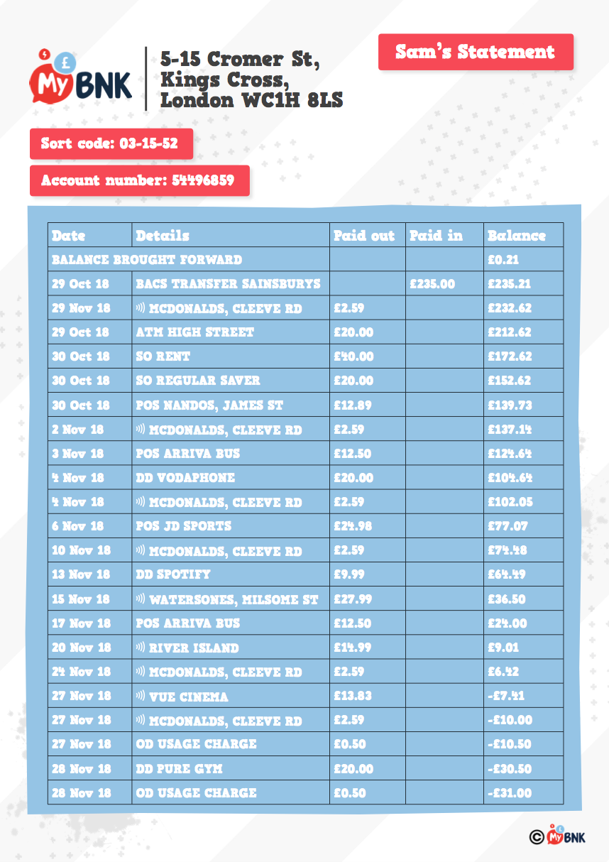
Banks will provide you with a statement – a summary of your transactions
Why are bank statements useful?

Slide 7
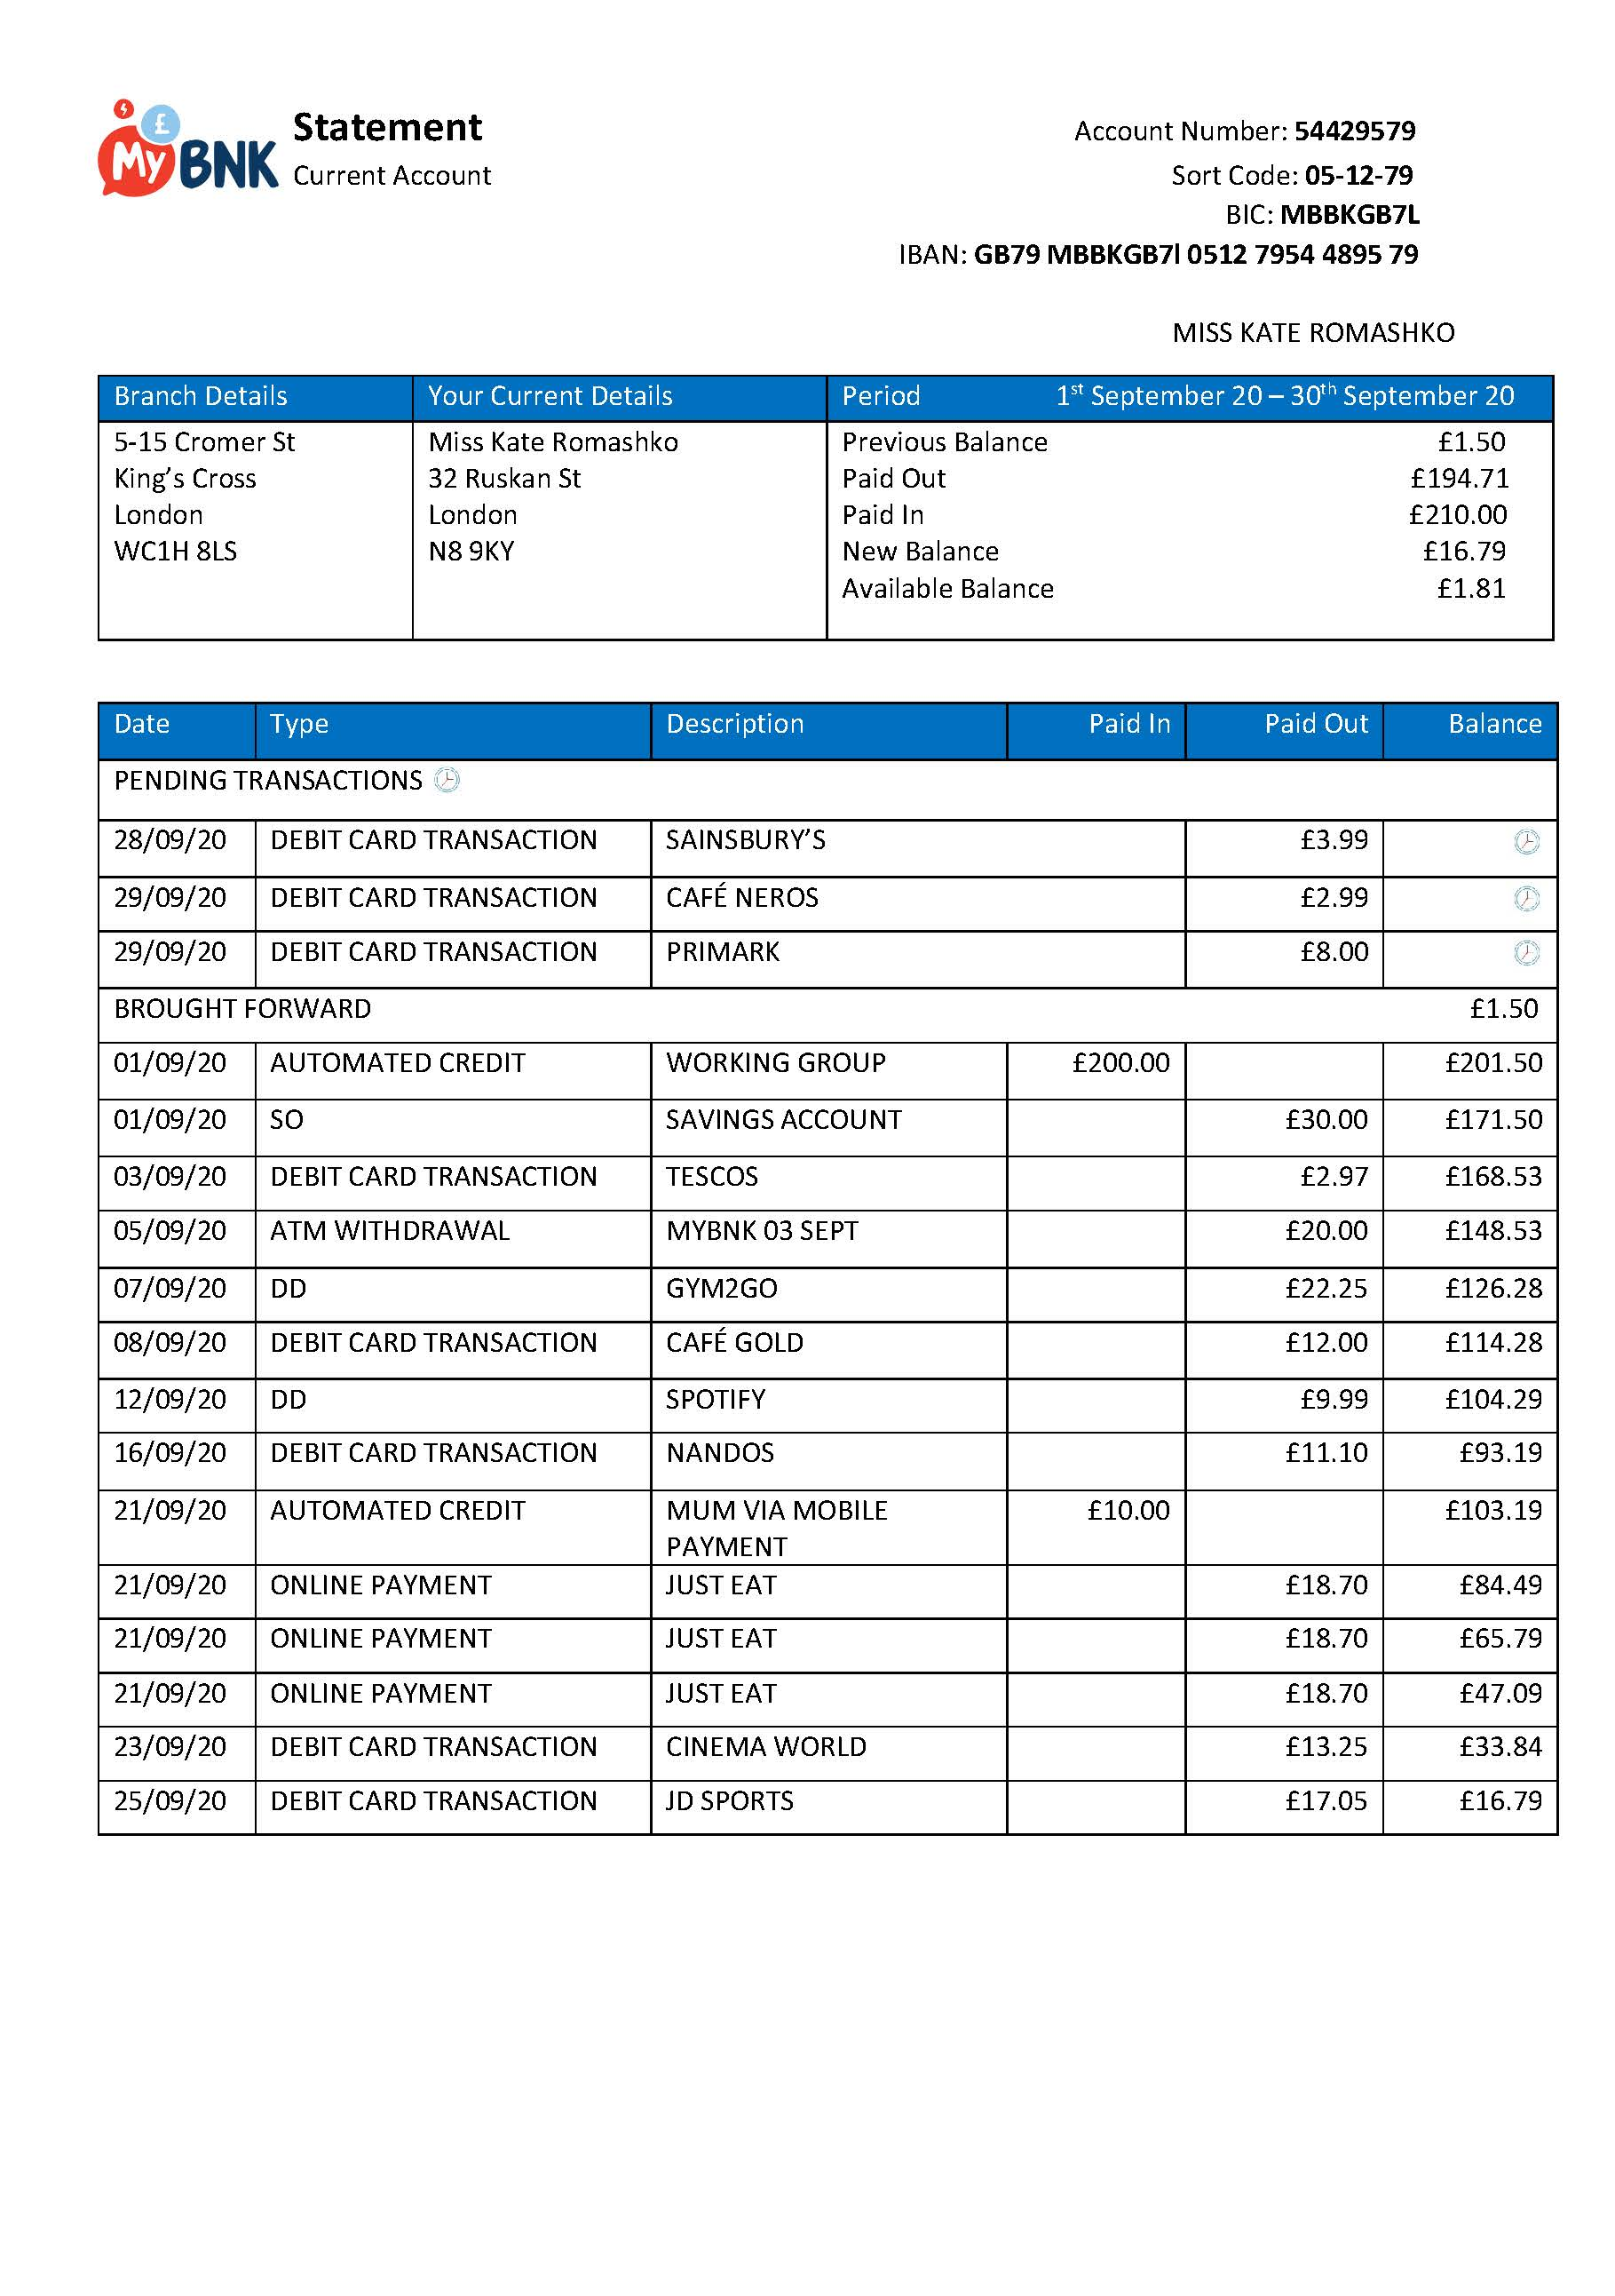
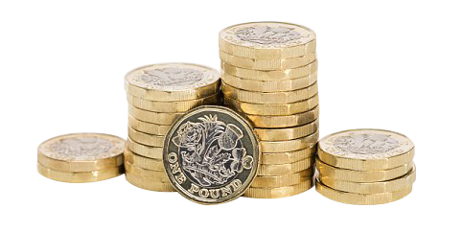
Bank Statements
Standing Order
Issued monthly. They can help you:
• Keep track of your cash
• Identify errors
• Recognise spending habits
Monthly Spends
Direct Debit
An official document – they’re often requested as proof of address.
Potential Errors

Slide 8
CURRENT ACCOUNT
SAVINGS ACCOUNT
Instant access
Varied access
Debit / Cash card
No debit card
Overdraft
No overdrafts available
Automatic payments
No auto payments available
Lower or zero interest rate
Better interest rate

Slide 9
SAVING OR
BORROWING
WHAT DO
YOU WANT
APR vs AER
AER
EARN
ON SAVINGS
HIGHER
ANNUAL
EQUIVELANT
RATE
Average AER:
0.25% - 2.00%
APR
PAY FOR BORROWING
LOWER
ANNUAL
PERCENTAGE
RATE
Average APR:
4.5% for most loans and up to 35% on credit cards

Slide 10
WHAT IS OPEN BANKING
Notes:
Add some shopping bags and money signs
http://www.uswitch.com/current-accounts/standard/
Uswitch comparison. Show YP the uswitch website and talk through accounts. Provide visual demonstration of shopping for a current account and discuss best options to suit personal circumstances.
What does these terms mean?

Slide 11
”FINTECH” APPS
Online Only Banks – banks on your mobile!
Starling
Monzo

Slide 12
”FINTECH” APPS
Banking services apps – apps that help with your money
Curve
Wonderbill
Moneybox

Slide 13
SHOPPING FOR A BANK
APR
EAR
AER
Notes:
Add some shopping bags and money signs
http://www.uswitch.com/current-accounts/standard/
Uswitch comparison. Show YP the uswitch website and talk through accounts. Provide visual demonstration of shopping for a current account and discuss best options to suit personal circumstances.
What does these terms mean?

Slide 14
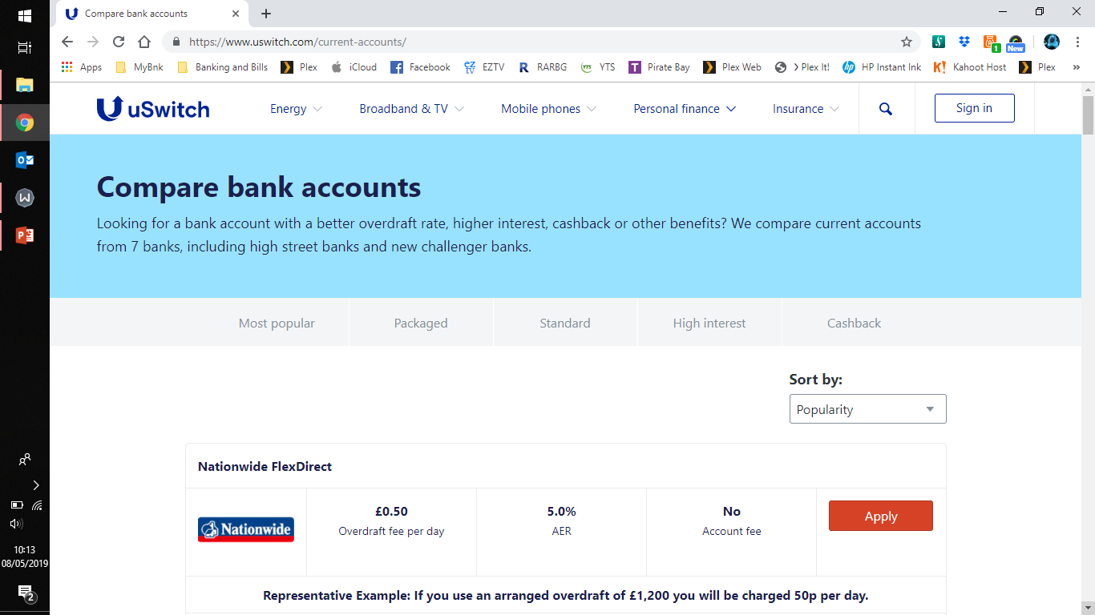
COMPARING BANKS

Slide 15
Ways to Pay
Apple Pay
Pay using phone
Shops / restaurants or transport
Cheque
Paper slip
Gifts or bills
Credit Card
Borrowed money on a card
Buy now pay later, holidays/sofa
Debit Card
Your money on a card
Online or in a shop
Online Banking
Using the computer to bank/send money
Send money to savings / others directly
Contactless
Tap to pay – max £100
Shops or transport
Cash
Physical money
Markets, shops or fair ground
Standing Order
Automatic payment, same amount each time
Paying rent

Slide 16
BANKING & BEING INFORMED
How banks work & Interest
Savings & current accounts
Forms of payment
Online banking system
Understanding contracts & tenancies
Session 3

Slide 17
BORROWING & AVOIDING SCAMS
Borrowing
Dealing with debt
Credit history
Avoiding eviction
Setting goals
Session 4

Slide 18
MAKE MONEY WORK FOR YOU!

